Slide 1
AI-Based Predictive Maintenance of Wind Turbines Using Machine Learning
Team Members: GUIDE:
HARITHA D[111923CS01051] Dr. VADIVELAN
LEKHA C[111923CS01077] CSE
KOMESHWARI M[111923CS01073] 2026 - 2027

Slide 2
PROBLEM STATEMENT
Wind turbines operate continuously under changing environmental and mechanical conditions. Failure of critical components such as the gearbox, generator and bearings can cause unexpected downtime and high maintenance costs.
Traditional maintenance approaches mainly depend on:
  Scheduled maintenance
  Reactive maintenance after failure
  Manual monitoring of turbine parameters
  Basic threshold-based alarms
These approaches may not identify degradation before a failure occurs.

Slide 3
OBJECTIVE
Main Objective
  To develop an AI-based predictive maintenance system for wind turbines using SCADA data and machine learning.
Specific Objectives
  Collect and understand SCADA sensor data with historical failure information.
  Create pre-fault labels using documented failure timestamps.
  Extract meaningful temporal and degradation-related features from sensor readings.
  Train and compare machine-learning models for early failure prediction.
  Evaluate models using Precision, Recall, F1-score, ROC-AUC and average lead time.
  Develop a dashboard showing turbine risk status and maintenance recommendations.

Slide 4
MOTIVATION
Why Predictive Maintenance?
  Wind turbine failures can cause unexpected downtime.
  Maintenance activities can be expensive, particularly when failures are discovered late.
  SCADA systems already collect large amounts of operational data.
  This data contains information about turbine operating behaviour.
  Machine learning can identify patterns that are difficult to monitor manually.
  Early warning provides an opportunity to plan maintenance before a critical failure.

Slide 5
EXISTING SYSTEM
APPROACH | METHOD | LIMITATION
Reactive Maintanence | Repair after failure | Unexpected downtime
Predictive maintanence | Fixed maintanence schedule | May cause unnecessary maintanence
Manual monitoring | Engineers inspect sensor values | Difficult with many parameters
Threshold Alarms | Fixed limits | May miss gradual degradation
SCADA based monitoring | Monitor operational parameters | Many systems focus in current/anomalous behaviour rather than a defined pre-fault prediction window

Slide 6
PROPOSED SYSTEM
Our system will:
Obtain SCADA sensor data.
Create pre-fault and normal labels.
Generate temporal/degradation features.
Train machine-learning models.
Predict failure risk for future time windows.
Evaluate how early the model detects the upcoming failure.
Display the result through a Streamlit dashboard.
The dashboard will show:
Healthy
Maintenance Required
High Failure Risk
Confidence/risk score
Fault probability over time
Sensor trends
Maintenance recommendation
Estimated lead time when a prediction is flagged

Slide 7
LITERATURE SURVEY
PAPER | YEAR | METHOD | LIMITATION
Two-Tier Machine Learning Framework | 2024 | Two-tier ML: fault detection + fault identification; ensemble classifiers + XAI | Accuracy is not 100%; only SMOTE was tested; not all ensemble combinations explored
Explainable AI Framework using RF-XGBoost | 2025 | RF + XGBoost hybrid, SMOTE, SelectKBest, LIME | Limited datasets/fault types and lack of large-scale validation in existing approaches
Generative Transfer Learning for New Wind Turbines | 2025 | ANN CycleGAN-based domain adaptation + Autoencoder NBM+ SCADA | Requires further validation across manufacturers, turbine systems and different fault types

Slide 8
PAPER | YEAR | METHOD | LIMITATION
Short-Term Fault Prediction of Wind Turbines Based on Integrated RNN-LSTM | 2024 | RNN-LSTM + SCADA | Deep-learning approach
A SCADA-Data-Driven Condition Monitoring Method of Wind Turbine Generators | 2022 | SAE + LightGBM | Condition monitoring / fault classification

Slide 9
GAP ANALYSIS
EXISTING WORK | RESEARCH GAP | PROPOSED APPROACH
SCADA-based monitoring | Often focuses on anomaly/current condition | Define a pre-fault prediction window
Temperature prediction | Predicts expected component temperature | Predict failure risk using documented failure timestamps
Generic SCADA datasets | May not contain failure timestamps | Use EDP/CARE data with failure information
Healthy/Fault classification | Does not show how early the prediction occurred | Measure average lead time
Standard accuracy metrics | Accuracy can be misleading for rare failures | Use Precision, Recall, F1, ROC-AUC + lead time
Single anomaly detector | May produce false alarms | Compare supervised prediction with anomaly-detection signal

Slide 10
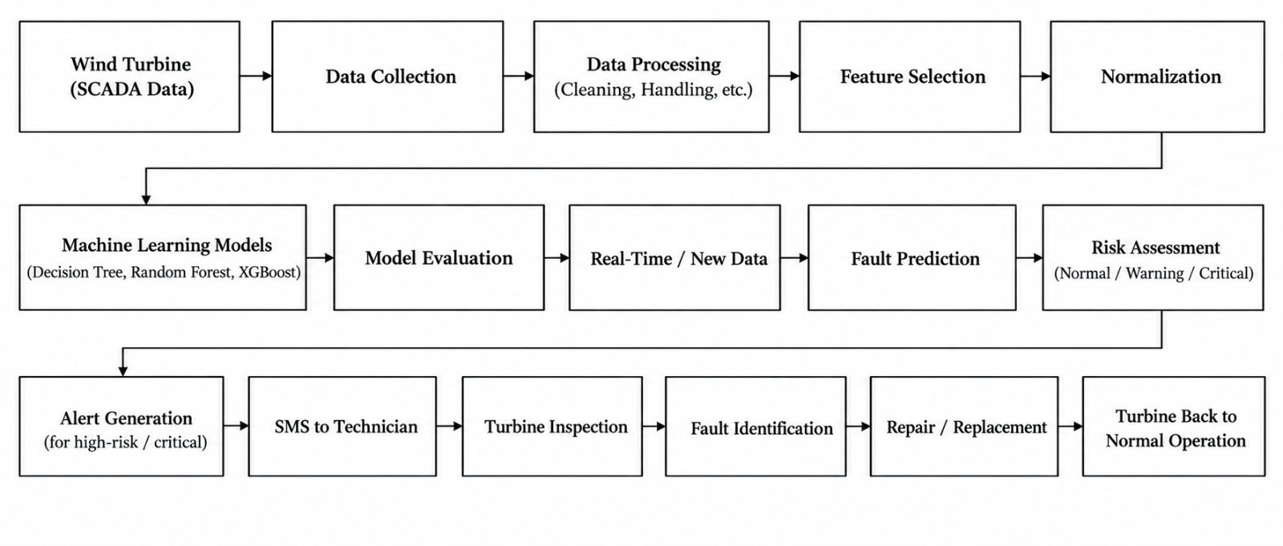
ARCHITECTURE

Slide 11
MODULE DESCRIPTION
Module 1 — SCADA Data Collection
Obtain historical wind turbine SCADA data from the Zenodo dataset.
Identify relevant turbine parameters such as wind speed, temperature, power, rotor/generator speed, etc.
Select the required turbine and features for experimentation.
Module 2 — Data Preprocessing
Handle missing values.
Remove duplicate records.
Detect and handle abnormal/outlier values.
Normalize/standardize numerical features where required.
Prepare the dataset for machine-learning modes.

Slide 12
Module 3 — Feature Engineering & Selection
Analyze relationships between turbine parameters and faults.
Select important features.
Remove irrelevant/redundant features.
Prepare the final feature set for model training.
Module 4 — Model Development
Divide the dataset into training and testing data.
Train different ML algorithms:
Decision Tree
Random Forest
XGBoost

Slide 13
Module 5 — Model Testing & Evaluation
Use the unseen testing dataset to generate predictions.
Compare predicted labels with actual labels.
Calculate:
Accuracy
Precision
Recall
Module 6 — Health Prediction & Maintenance Recommendation
The selected model predicts the turbine's condition.
Example:
Healthy → Continue monitoring
Warning → Inspect component
Fault/Risk → Schedule maintenance

Slide 14
Module 7 — Monitoring Dashboard
Develop a Streamlit dashboard to display:
Current turbine health status
Fault probability/risk
Sensor parameter trends
Model prediction
Alerts
Maintenance recommendation
Model performance

Slide 15
Software & Hardware Requirements
SOFTWARE
HARDWARE
  Python
  Jupyter Notebook
  VS Code
  Pandas
  NumPy
  Scikit-learn
  XGBoost
  Matplotlib / Plotly
  Streamlit
Laptop/PC
Minimum 8 GB RAM
Sufficient storage for the selected dataset
Internet connection for dataset acquisition

Slide 16
DATASET DETAILS
The dataset contains:
wind turbines
wind farms
sub-datasets
turbine-years of operating data
anomaly-event datasets
normal-behaviour datasets

Slide 17
Data Types
SCADA sensor measurements
Examples
  Wind speed
  Power-related variables
  Temperature-related sensors
  Rotor/generator-related measurements
  Other turbine operational sensors
Failure Information
  Turbine status information
  Anomaly event information
  Fault-related timestamps

Slide 18
Algorithms / Technologies
1. Decision Tree
Takes selected SCADA features as input.
Learns decision rules from “Normal and Pre-Fault” training data.
Uses the learned rules to classify unseen turbine observations.
Serves as a simple baseline model for comparison.
2. Random Forest
Takes the same preprocessed SCADA features.
Builds multiple decision trees using different data/feature samples.
Combines the predictions of the trees to classify “Normal or Pre-Fault” conditions.
Provides a more robust model for comparison.

Slide 19
3. XGBoost
Takes the same SCADA features and target labels.
Builds decision trees sequentially, giving more attention to previous prediction errors.
Combines the trees to predict “Normal or Pre-Fault” conditions.
Its performance is compared with Decision Tree and Random Forest.

Slide 20
EXPECTED OUTCOME
Clean and preprocess wind turbine SCADA data.
Identify important features related to turbine faults.
Develop and compare multiple ML models.
Predict turbine health as Healthy / Warning / Fault Risk.
Generate maintenance recommendations based on prediction.
Develop an interactive Streamlit dashboard for monitoring and visualization.

Slide 21
WORK COMPLETED
Completed
Problem Identification
Literature Survey
Requirement Analysis
Technology Selection
System Architecture
Database Design
In Progress
Dataset Collection
AI Model Implementation

Slide 22
GANTT CHART
Activity | Aug | Sep | Oct | Nov
Literature Survey | ✓
Dataset Collection | ✓ | ✓
Development |  | ✓ | ✓
Testing |  |  | ✓ | ✓
Documentation |  |  |  | ✓

Slide 23
REFERENCE
“A Multi-View Spatio-Temporal Feature Fusion Approach for Wind Turbine Condition Monitoring Based on SCADA Data,” IEEE, 2024.
“SCADA Data-Driven Spatio-Temporal Graph Convolutional Neural Network for Wind Turbine Fault Diagnosis,” IEEE, 2025.
“An Anomaly Detection Approach Based on Machine Learning and SCADA Data for Condition Monitoring of Wind Turbines,” IEEE, 2018.
M. Hussain et al., “Condition Monitoring and Fault Diagnosis of Wind Turbine: A Systematic Literature Review,” IEEE Access, 2024.
X. Jin et al., “Condition Monitoring of Wind Turbine Generators Based on SCADA Data and Feature Transfer Learning,” IEEE Access, 2023.

Slide 24
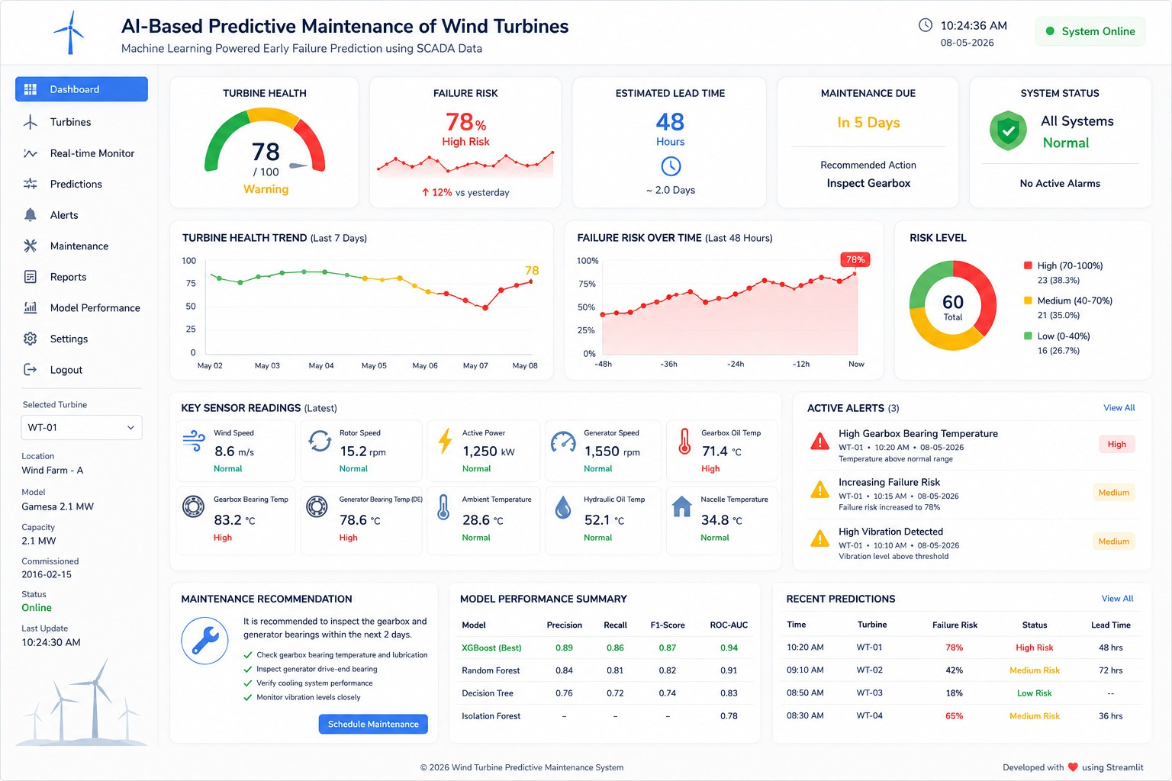
UI DESIGN

